Slide 1

Chat Application
Raj Nikam(21104032)
Yash Kasar(21104115)
Atharva Makode(21104013)
Hitesh Dubey(21104120)
Project Guide
Prof. Jayshree Jha

Slide 2
Contents
Introduction
Objectives
Scope
Features / Functionality
Project Outcomes
Technology Stack
Block Diagram if applicable

Slide 3
1. Introduction
The chat application which makes easy to communicate with people anywhere in the world by sending or receiving messages in real time
Chatting is a method of using technology to bring people and ideas together
Problem Identified :
    The technology to provide the chatting facility has been available for years but the acceptance is quite recent
Solution Proposed :
    A chatting app which used to let people communicate learn, and share study materials easily.

Slide 4
2. Objectives
To build a user friendly as well as efficient chat application.
To make communication a lot more easier and without delay.
To attract more and more peoples towards technology.

Slide 5
3. Scope
A chat app which will provide real-time messaging capabilities allowing users to send & receive messages instantly.
Our project would have a system for managing user account including user registration, login and profile management.
Media sharing allows users to share images, videos and other files.
Marketing and publicity can be done between users.

Slide 6
4. Feature /Functionality
Feature 1 :
    User can send , receive and delete the message . User can search his friends by entering his username
Feature 2 :
    User can able to create room or group & send messages to multiple people at once.
Feature 3 :
    Admin can set a profile picture as well as user can edit his profile.

Slide 7
5. Outcome of Project
User can log in & set password
User can create new account by entering his username and password.
Used can able to
      Send and receive the message
      Admin can set his profile picture

Slide 8
6. Technology Stack
Write what you have planned to develop front end ( GUI ) & Backend (Database if applicable)
- PYTHON
- REACT
- FAST- apr.

Slide 9
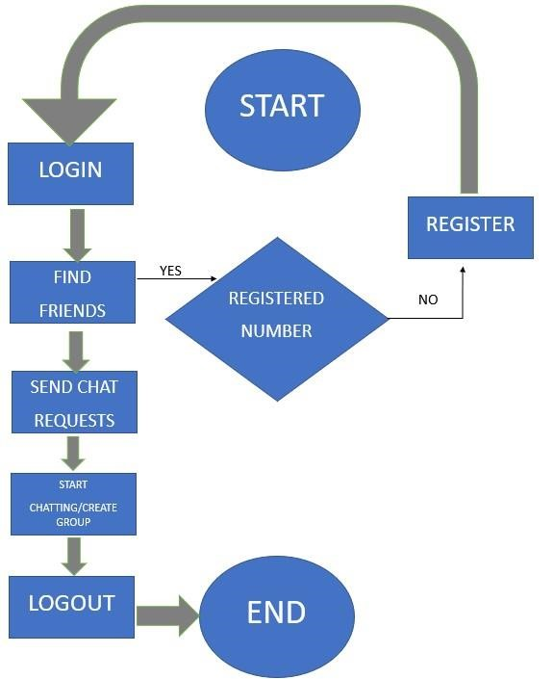
7. Block Diagram

Slide 10
Thank You...!!

